Slide 1
HKJC Data Strategy
HKJC Data Strategy
HKJC Data Strategy Overview
HKJC Data Strategy Enablement

Slide 2


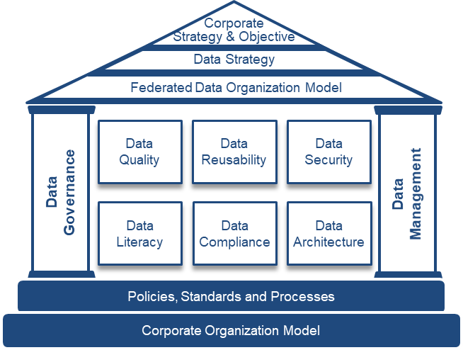
HKJC Data Strategy
Draft for Discussion
Promote healthy data over quality, reliability, reusability, and be available on an effective marketplace
Having a common mindset to leverage analytical data for confident decision-making, increase innovation and improve efficiency
“Make data-driven decisions using trusted data to drive business outcomes by leveraging a club-wise federated data governance”
Using a common language between Business & IT shifting from technology focus to product/service focus
Collaborate through a single operating model to create, monitor and enforce data standards and accountability
Notes:
drives data democratization to embed data in all decision making, builds user trust, increases brand value, reduces the chances of compliance violations
Data driven decision – design approach, data accessible
Trusted data – data standard and measures
Business outcome – align Business and IT on common goal shifting from technology to produce/service focus
Federated data governance – single operating model, r/r and process

Slide 3
HKJC Data Strategy Overview
Drives data democratization to embed data in all decision making, builds user trust, increases brand value, reduces the chances of compliance violations
Common Definition of Business Data
International Standard
Big Data Integration
Enterprise Conformance
Single Source of Truth
Standard Data Structure
(common language)
Federated Data Governance
(single operating model)
Data Standards
(healthy data)
Interoperable
Observable
Discoverable
Changeable
Addressable
Secured
Trustworthy
Data Quality
Data Reliability
Data Security
Data Literacy
Data Compliance
Data Architecture
Data Ownership
Data Driven Decision
Trusted Data
Business Outcome focus
Operation Efficiency
Data as a Product
(common mindset)

Slide 4










HKJC Data Strategy Enablement
Data Strategy
Data Governance*
Head of Service Delivery
Standard Data Structure
(common language)
Data Engineer
Reduce Data Translation Effort
Build to Align
Sponsor to Transform
Data Product Manager
Accelerate Data Assets Design and Production
Data as a Product
(common mindset)
Democratize to Value
Executive Manager
IT Data Analytic Solutions
(EDAP Program)
Data Standards
(healthy data)
Fund to Establish
Improve Data Quality and Compliance
Data Architect
Build EDAP to enable MVP
Govern to Improve
Federated Data Governance
(single operating model)
Increase Data Agility and Ownership
Drive to Standardize
Data Governance Consultant
Wagering
Sport
Manage to Design
Customer
Membership
Information Architect
Engage to Support
Wagering
Racing
Data Management
* Funding to Data Governance team to run in the future is to be determined

Slide 5
Appendix

Slide 6
Budget and Cost Estimation
Data Governance Ballpark for 2023
Resource | Monthly Rate (HKD in unit of $1,000) | Budget Period | Budget Total (HKD in unit of $1,000) | Q3 22-23 Cost (HKD in unit of $1,000) Jan-23 to Mar-23 | Charging Model
Design and Implementation (Jan-23 to Dec-23) |  | Total: | 12600 | 3850
1x Data Engineer 1x Data Product Manager 1x Data Architect | 700 | Jan-23 to Dec-23 Jan-23 to Dec-23 Jan-23 to Jun-23 | 6600 | 1650 | T&M (e.g. 6 months initial then 3 months rolling)
1x Data Governance Consulting Service | n/a | Jan-23 to Mar-23 Apr-23 to Jun-23 | 2200 (Inception) 3800 (Implement) | 2200 n/a | TBD (3 months) TBD (3 months)
Run (starting Jul-23 and ongoing) |  | Total: | 1200 (per annual) | n/a
1x Data Architect | 100 | Jul-23 (starting) | n/a | n/a | Permanent Staff

Slide 7



RW2 Outcomes and Data Products
Draft for Discussion
Focus on the business outcomes using data products through data-driven design
Sharing Data
Target State
Data Product
Integration
Service
Application
Milestones
CustomerBetAccount
…
API.BetAccount
…
PlaceRaceBet
…
RW2 Programs
DLT
CDP
EDAP
Cloud Pass
CustomerProfile
…
Q.Customer
…
GetCusProfile
…
login
Place
CustomerSegment
HorseOwnerBetPattern
…
Q.CusSegment
Q.HOBetPat
…
GetBetRecommend
…
Recommend
CustomerAccess
…
LDAP.ExtCus
GetUserAuthenication
…
Use Case 3A:
Horse Population Modelling
Epic/User Stories
(outcomes)
3A5.1. Horse owner ….
Outcome
3A2.1. Horse owner’s spouse and friends…
.
Data-Driven Design with:
Data Conformance
Data Contract
Data Pipeline
Data Catalog
Data Change Log
Data Service
3A2.1. Horse owner is invited to VIP party after
…
3A1.1. Horse owner receives active & real-time betting recommendation and place bet on Racing Touch during race event date
3A1.2. Horse owner’s relationship manager can assist to place bet for horse owner based on the recommendation or modified at the race course during race event date
3A1.3 ….

Slide 8
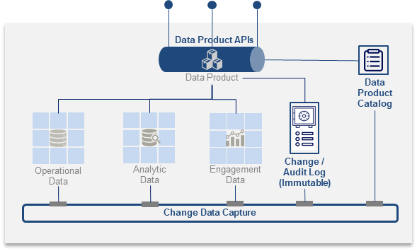







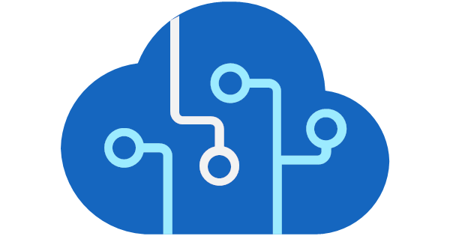





Data Standards
Draft for Discussion
Data Management applies and provides measure for data standards
Domain Data Management
Federated Support
Align
Validate
Enable
Data
Standards
of
Customer
Interoperable
Observable
Discoverable
Changeable
Addressable
Secured
Trustworthy
of
Membership
Data
Products
Consumption Layer
Govern
Codify
Provision Layer
Enterprise Data Governance
of
Wagering
Racing
of
Wagering
Sport
Provide Computational Data
Each domain implement and execute the standards through its data management platform
Notes:
Data Product Standard characteristics detail:
Interoperable – conformed to canonical data model; ability to align in common enterprise data model
Observable – provision as data API/service; ability to able constant monitoring of the behavior of the data in data pipeline
Discoverable – described in data catalog; ability to find and understand the data quickly and accurately with features to search, tag, rank, query to understand the origin (5W1H), literacy, usage, lineage, history etc.
Changeable – bound with data contract; ability to mange data change with availability, error rates, versioning, compatibility and environment through terms of service and SLA to minimize the impact
Addressable – tracked via data change log; ability to trace the lineage including the origin and flow of data
Secured – accessed with data access control; ability to align to security policy to handle access provisioning and security enforcement to ensure safe and right access
Trustworthy - heath checked by data usage;

Slide 9
Enterprise Data Governance Framework
Draft for Discussion
Data Governance and Data Management are the pillars to support corporate data strategy and objectives
Data Governance
Data Management
Policies, rules and controls to governing the data and managing data quality. It refers to the strategy and framework to establish process and theories
Achieve business goals and reduce risk, add truest and understanding to organization's data
Philosophical focused on an overall business strategy, and reliability and safety of data
Multiple members of an enterprise holistically build a framework for data management
Corporate
Strategy & Objective
Methods of how data is organized. It refers to the practice of collecting, organizing, protecting, processing, sorting and maintaining data
Assure the accuracy, accessibility and availability of data to be processed and analyzed
Logistical and focused on technology and increase data quality and valuably
Primarily the responsibility of IT to implement the framework to manage data
Data Strategy
Federated Data Organization Model
Data
Quality
Data Reusability
Data Security
Data
Governance
Data Management
Data Literacy
Data Compliance
Data Architecture
Policies, Standards and Processes
Corporate Organization Model
Data Metrics are the building blocks to solidify the structure
Notes:
maximize the value derived from data, build user trust, and ensure compliance by implementing required security measures
drives data democratization to embed data in all decision making, builds user trust, increases brand value, reduces the chances of compliance violations

Slide 10
Definition
Draft for Discussion
Term | Definition
Data | including Operational, analytic, and engagement data spanning databases, data warehouses, and data lakes (etc) that is organized in domains owned by a product owner
Data Events | That define and describe any state change, command, or data transmission related to the data product; Events are generated from many sources including data product APIs (each request can be an event), change data capture (each change in data is an event), and data catalog changes (changes in meta-data are events that are published to interested subscribers)
Data Product APIs | that make data within a data product accessible via a contract that is consistent, uniform, and compliant to industry standard specifications (OpenAPI, or any other mechanism such as GraphQL, MQQT, gRPC etc)
Data Product Catalog | that describe the data residing in the data product while providing a user interface and APIs that make it easy for both users and machines to consume data products; Data product catalogs integrate into an enterprise data catalog which provides a consistent enterprise view of all data products
Data Product Change Data Capture | that captures all changes to the data in the data product and notifies interested subscribers of those changes, making it simple to communicate changes to elements of the data product both within the data product (for example, keeping the analytics data store updated with changes to the operational databases) and to the broader organization (for example, where “account” domains may require information changes in a separate “customer” domain)
Data Product Immutable Change/Audit Log | that tracks and logs all changes to the data product to support federated governance as well as audit requirements
Enterprise Event Streaming Platform | that makes it simple to communicate data events within a data product as well as across the enterprise

Slide 11







Data Governance Target Operating Model
Manage to Design
Drive to Standardize
Business HoD
IT HoD
Data Governance
Data Management
Data Owner
Data Engineer
Data Steward
Data Product Manager
Data Domains
Engage to Support
Wagering
Sport
Membership
Data Governor
Customer
Wagering
Racing
Data Custodian
Data Power User
Information Architect

